Slide 1
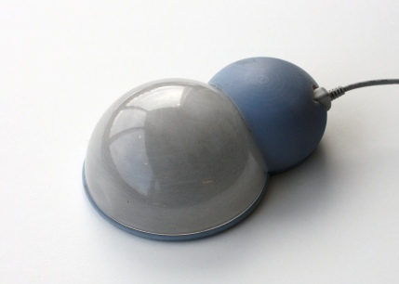
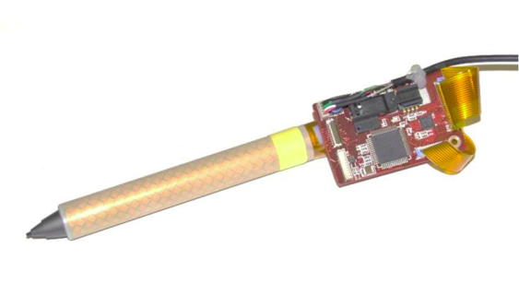
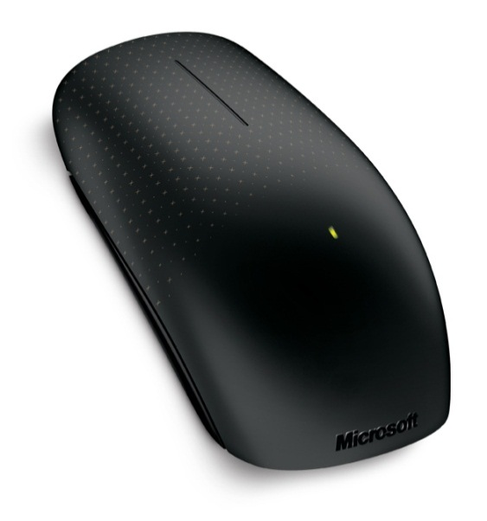
Multi-touch Interactions on Small Input Devices
Hrvoje Benko
Researcher Microsoft Research
DUB – February 2, 2011

Slide 2
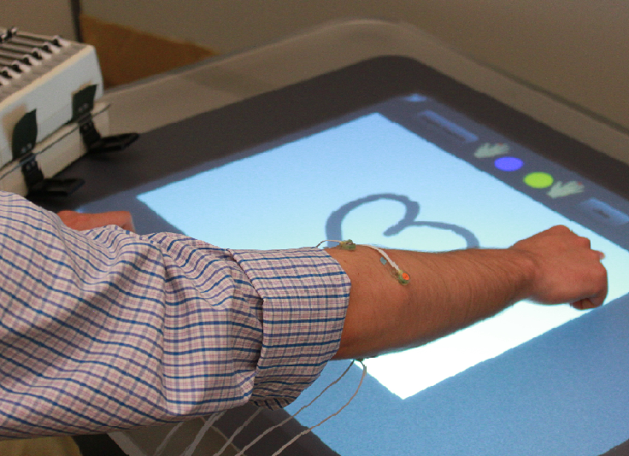
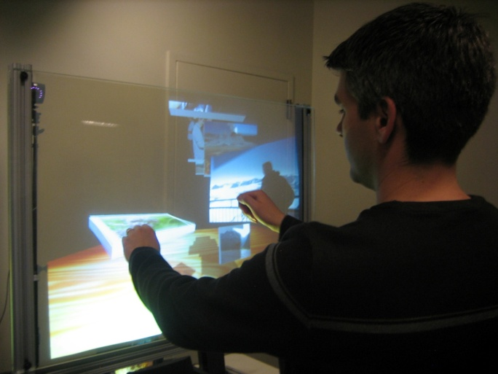
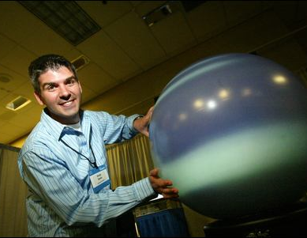
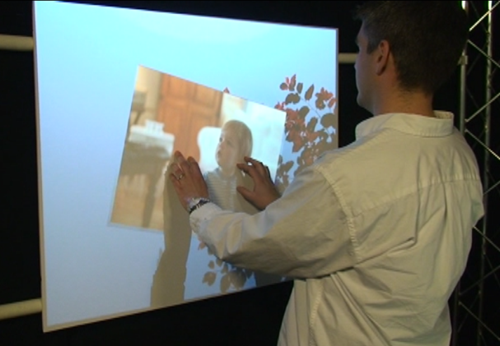
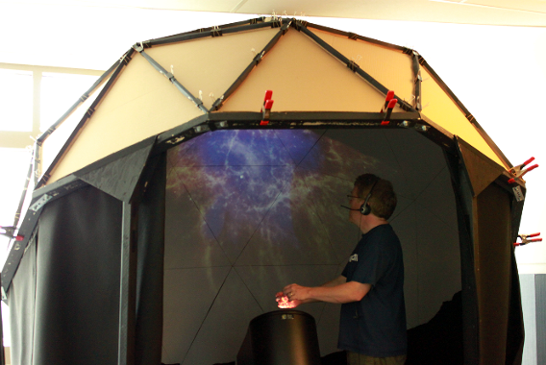
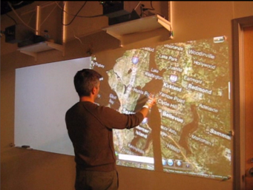
My research

Slide 3
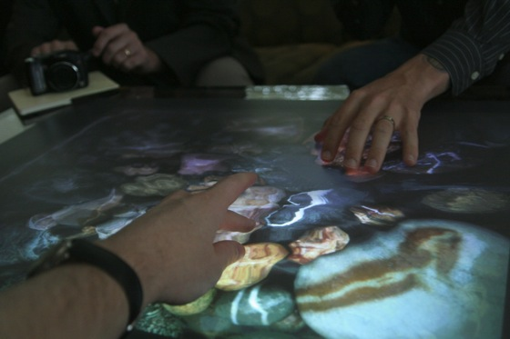
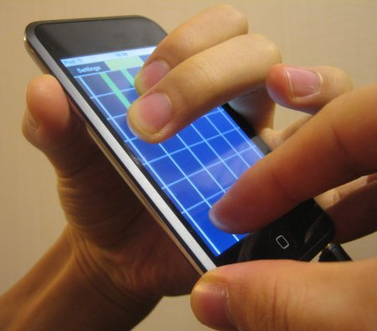
Multi-touch Interactions
Notes:
New and exciting way of interacting with computers: multi-touch
Often cited benefits: more dynamic, more fluid, more simultaneous degrees of freedom, no devices necessary to hold.

Slide 4
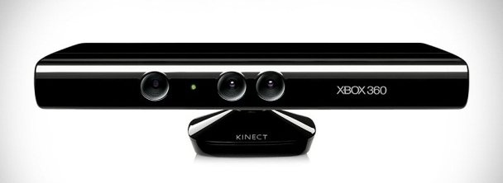
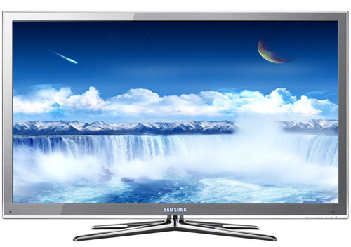
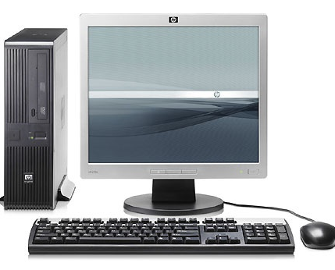
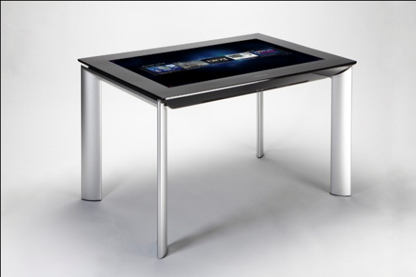
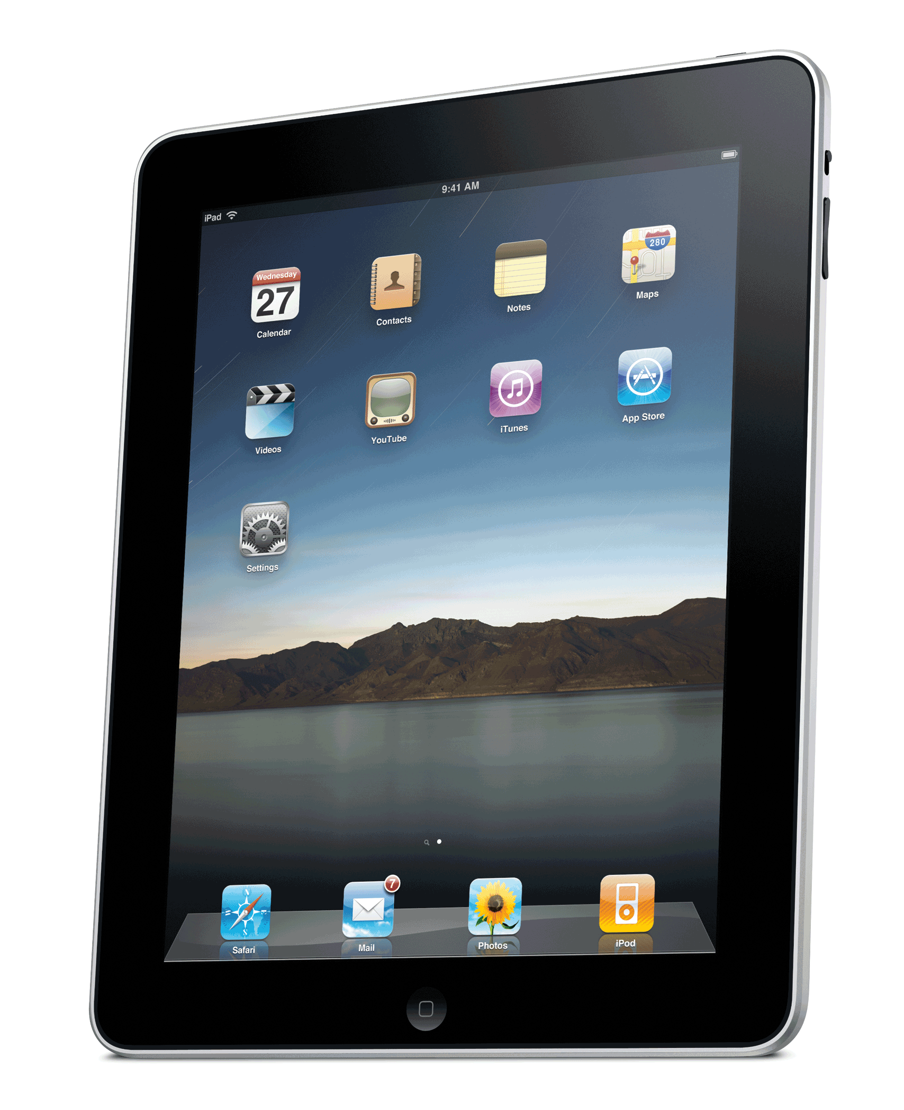
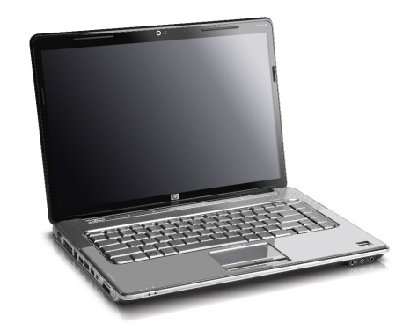
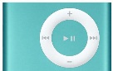
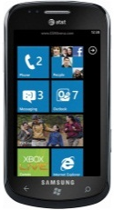
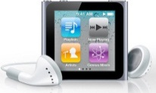
Computing Today
Touch/ Buttons
Touch
Touch
Keyboard & Touchpad
Keyboard & Mouse
Remote controller

Slide 5
Computing Today
Touch
“No” Touch
Touch/ Buttons
Touch
Touch
Keyboard & Touchpad
Keyboard & Mouse
Remote controller

Slide 6
Why “no” touch?

Slide 7
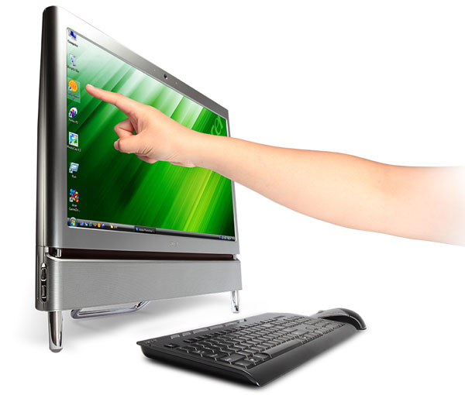
Ergonomics

Slide 8
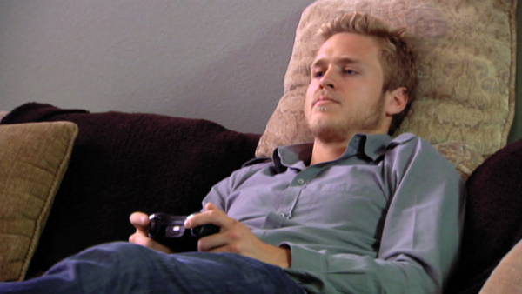
Interaction at a distance
focus is NOT on the device

Slide 9
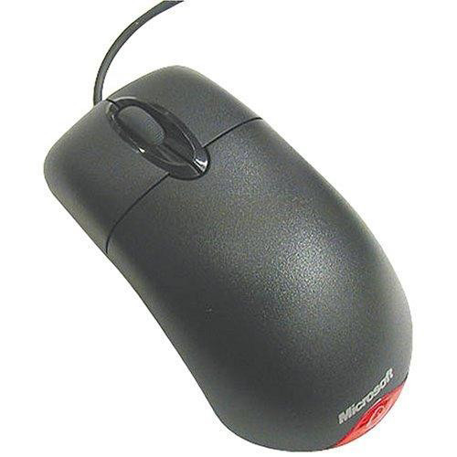
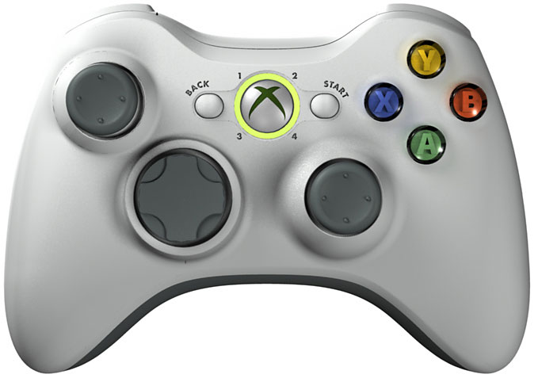
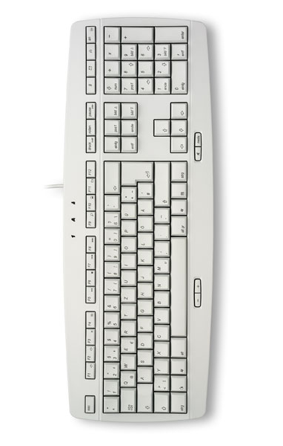
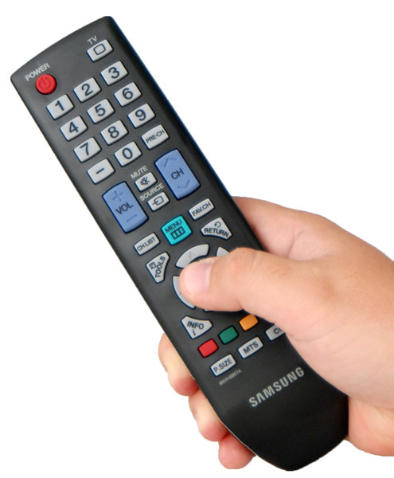
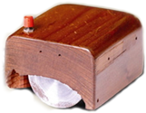
Existence of good input devices

Slide 10
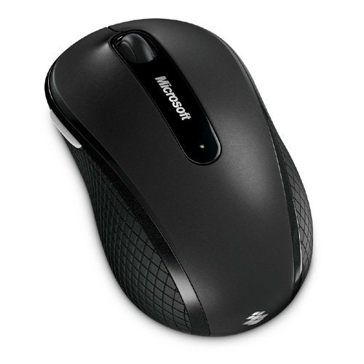
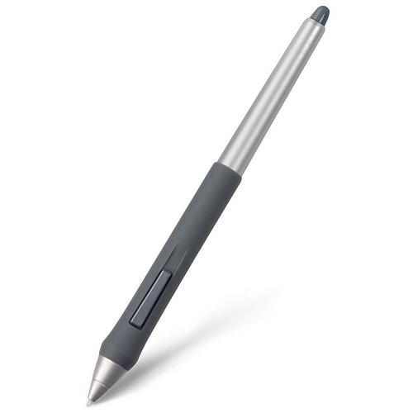
Rather than replace the existing input devices with touchscreens,
augment them with touch sensing to enable novel interactive possibilities.

Slide 11
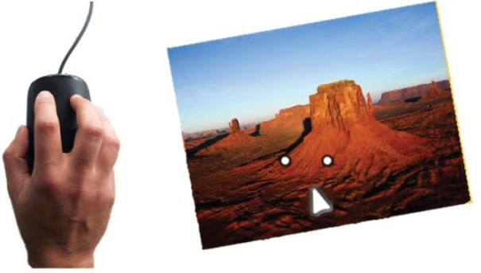
4 parts
Sensing hardware
Interactions
Grip vs. gesture
Making a product

Slide 12
Sensing HARDWARE
Part 1

Slide 13
Five mouse prototypes
Mouse 2.0: Multi-touch meets the mouse. UIST 2009
Nicolas Villar, Shahram Izadi, Dan Rosenfeld, John Helmes, Jonathan Westhues, Steve Hodges, Eyal Ofek, Alex Butler, Xiang Cao, Billy Chen
Notes:
“there are rumours of MT mice, but no one has seen one”
We wanted to take a broad approach at thinking about this
How do we build it , how do we do the sensing, ... AND ALSO how do we integrate it with the GUI
Investigate multiple different ways to implement MT mice
5 working prototypes. All work as a mouse (optical mouse sensor, you can click etc.)
Different techniques. Vision, capacitive, multiple mouse sensors.

Slide 14
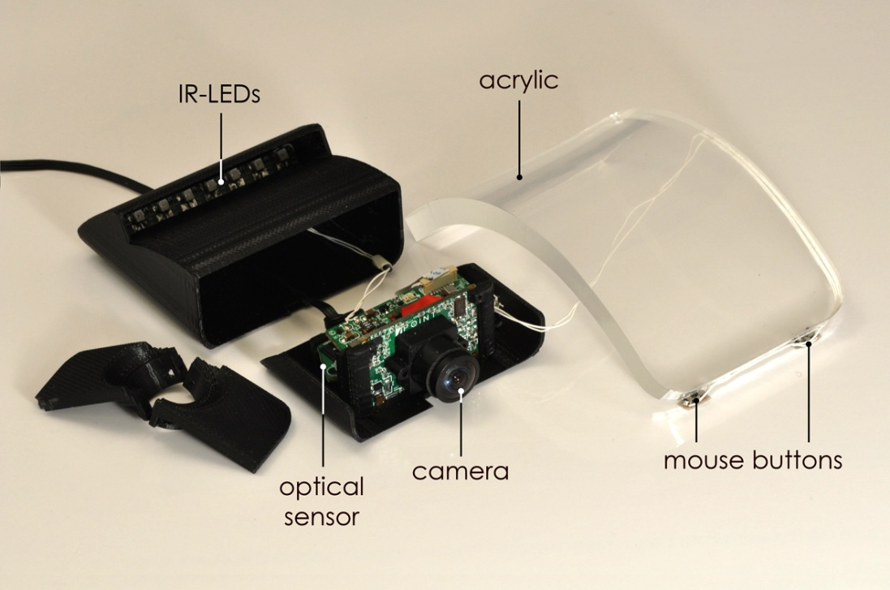
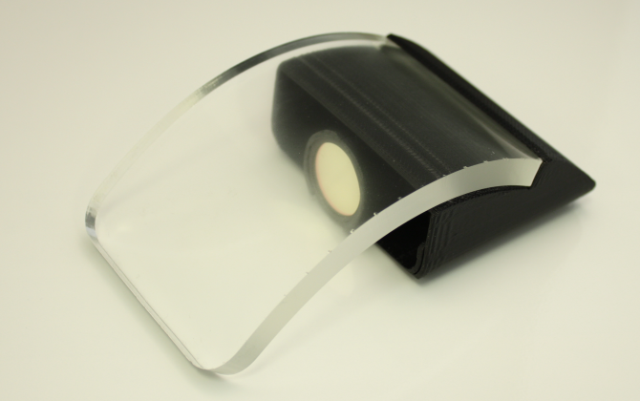
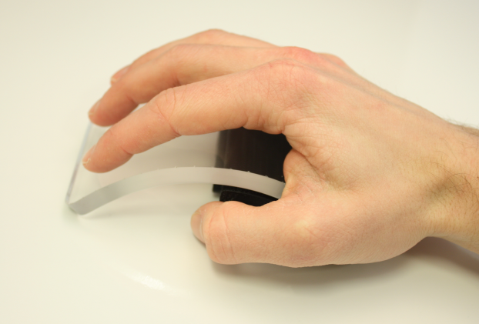
Prototype 1: FTIR Mouse

Slide 15
Prototype 1: FTIR Mouse

Slide 16
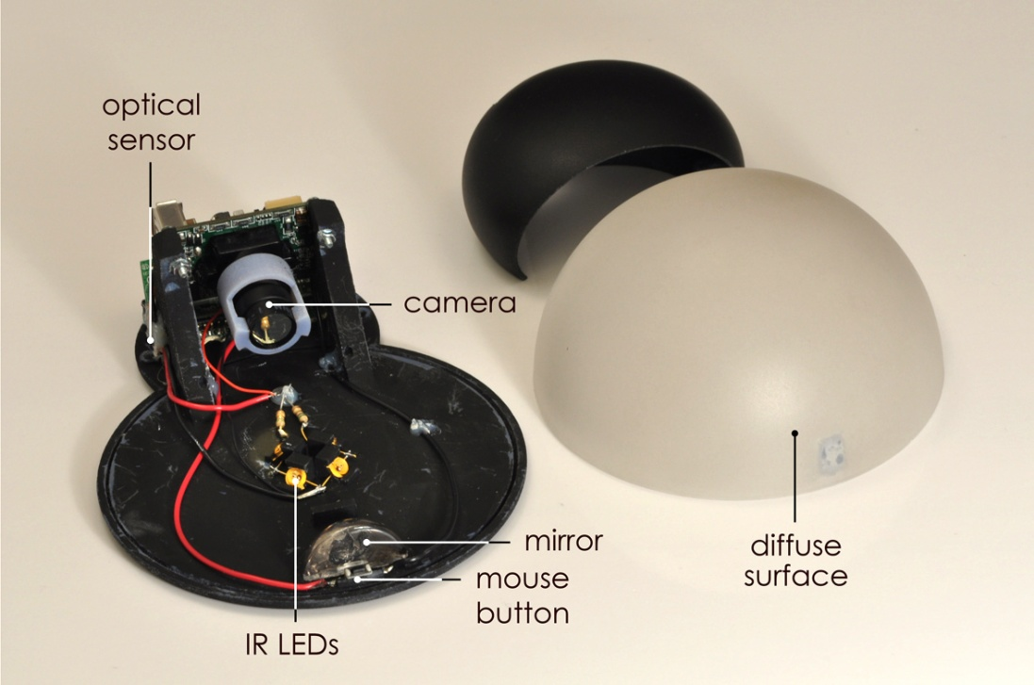
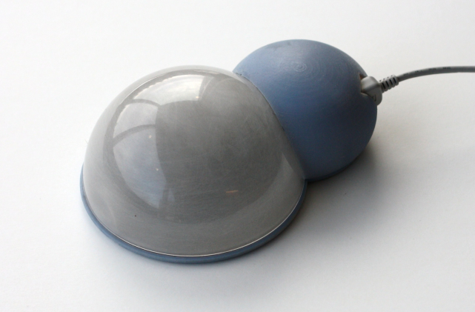
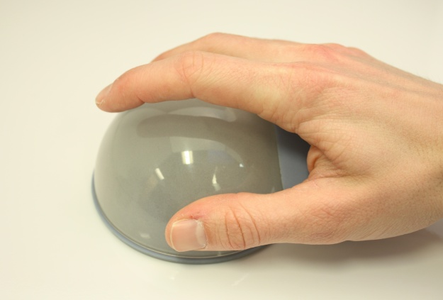
Prototype 2: Orb Mouse

Slide 17
Prototype 2: Orb Mouse

Slide 18
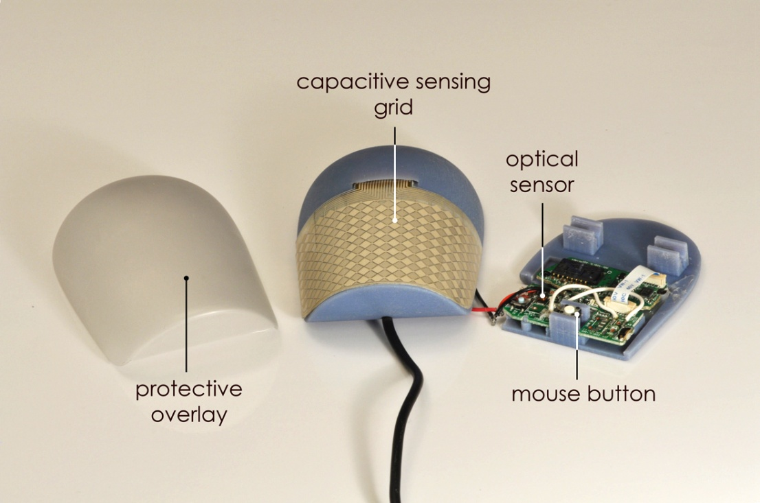
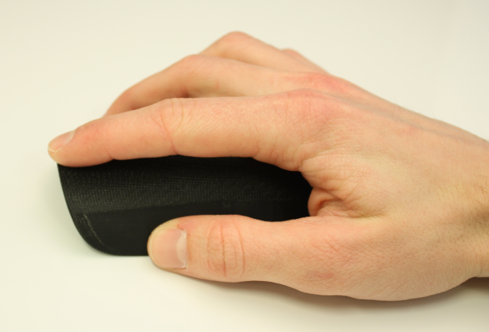
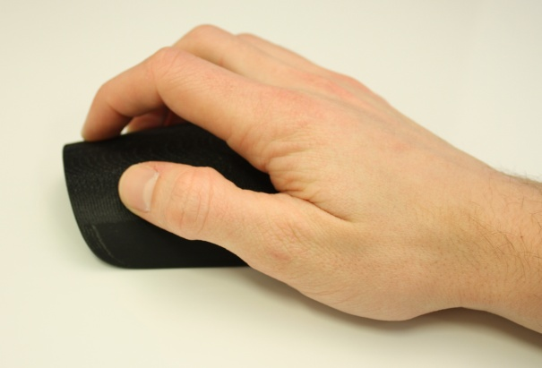
Prototype 3: Cap Mouse
Notes:
In form factor – not too different from a regular mouse
Array of multi-touch capacitive sensors
Curved MT – first time
Very intreresting possibilities for ID – have to do away with carbuncles
BUTTON: People like Buttons: When you click, you mechanically click the button – image processing determines whether it’s left or right click (same in other prototypes)

Slide 19
Prototype 3: Cap Mouse

Slide 20
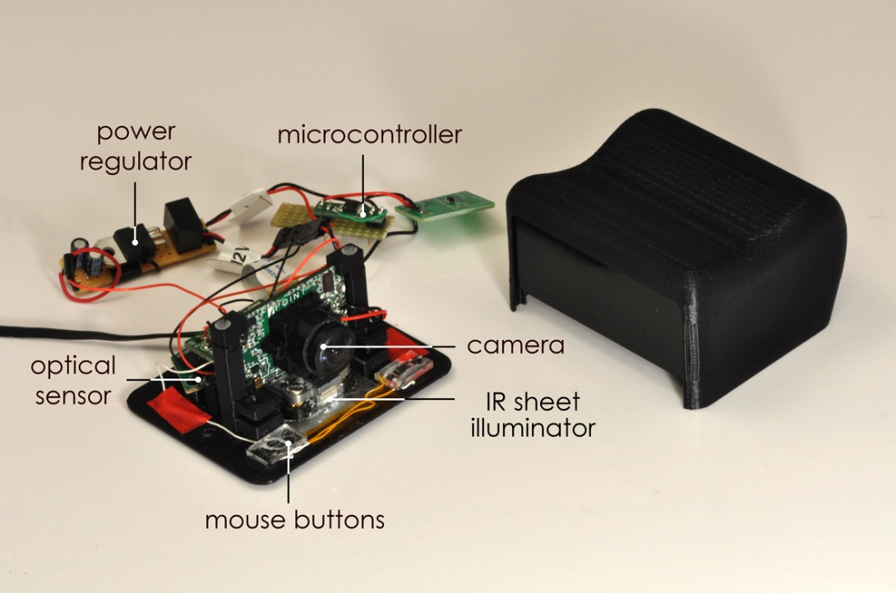
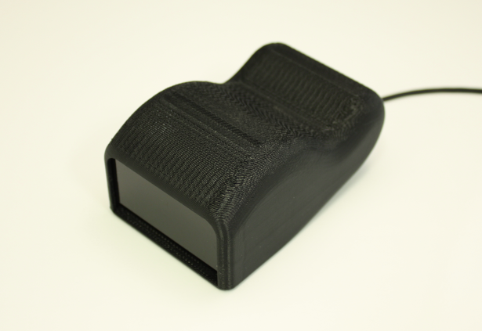
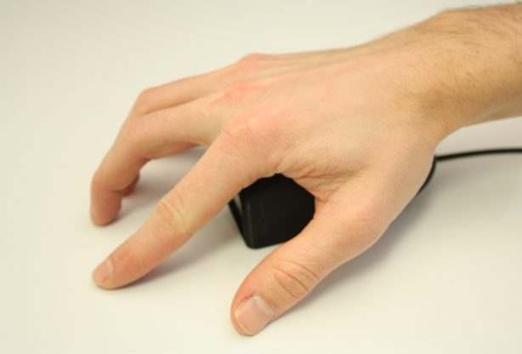
Prototype 4: Side Mouse

Slide 21
Prototype 4: Side Mouse

Slide 22
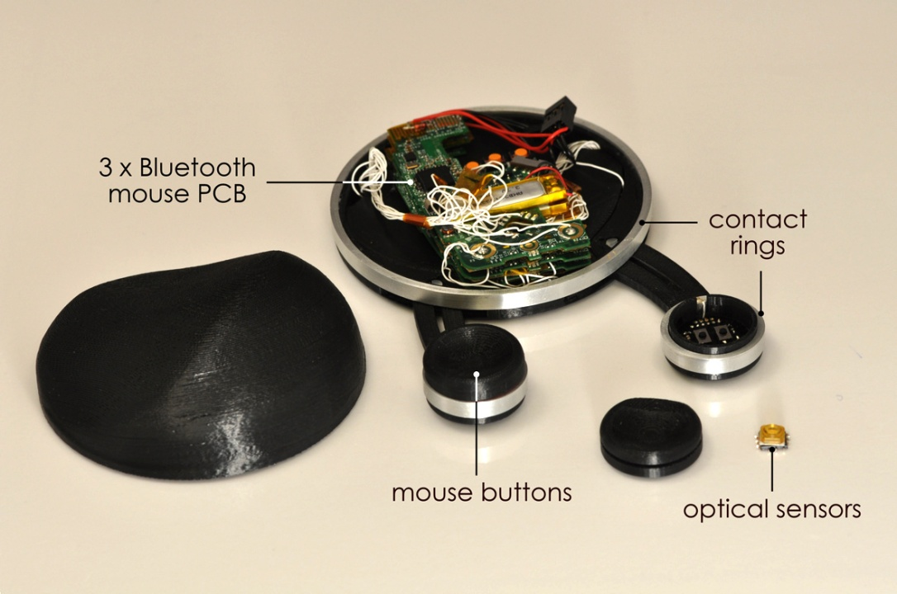
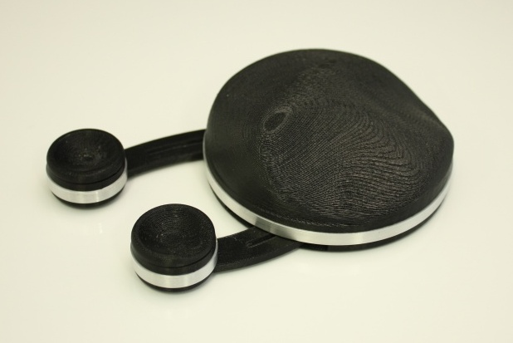
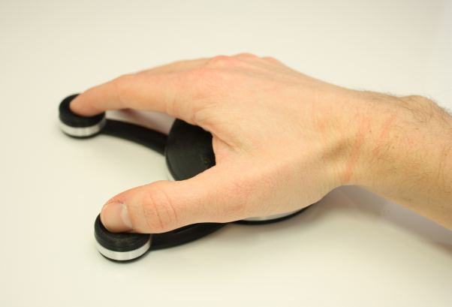
Prototype 5: Articulated Mouse
Notes:
Mechanically articulated – 3 parts, each with a mouse sensor
Supports thumb+index MT input – we found that most interesting MT gestures we considered could be performed with just these fingers.
Allows high precicion, individual mechanical buttons to be placed under the fingers. Also detect when fingers click

Slide 23
Prototype 5: Articulated Mouse

Slide 24
What is the best HW solution?
Biggest sensor area – Orb
Best touch resolution – FTIR
Most robust – Cap
Most precise – Arty
Dual purpose – Side

Slide 25
Interactions
Part 2

Slide 26
How to treat mouse + touch streams?
Independent
Combined
Mouse cursor used for manipulations
Touch used for gesturing
Touches manipulate the on-screen objects in addition to the cursor

Slide 27
INDEPENDENT

Slide 28
INDEPENDENT

Slide 29
COMBINED
Notes:
Bread and butter – Interacting with the windows explorer
MT Cloud Cursor One of the ideas we are experimenting with:
Standard cursor
Cloud of MT points arround it

Slide 30
COMBINED
Notes:
Professional design tools
Making use of high resultion
“Explicit controls”

Slide 31
COMBINED
Notes:
Side mouse....

Slide 32
COMBINED
Notes:
THOSE were some of the ways that we’re thinking about how to integrate with standard apps and the OS. MORE examples in the demos.
We want to integrate with APPS ORIGINAL DESIGNED FOR DIRECT MULTITOUCH.
Now we can drive them with a mouse.

Slide 33
How effective are multi-touch manipulations on a mouse?
Design and Evaluation of Interaction Models for Multi-touch Mice. GI 2010
Hrvoje Benko, Shahram Izadi, Andrew D. Wilson, Xiang Cao, Dan Rosenfeld, and Ken Hinckley

Slide 34
What is the focus model?

Slide 35
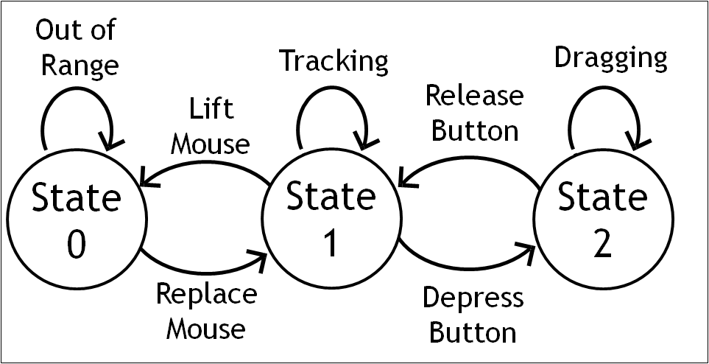
What is the activation model?
Touchscreen
(implicit)
Mouse
(explicit)

Slide 36
User Study Conditions
Cond. | Technique Name | Focus | Activation
IT | MT Mouse Independent Touches | No | Implicit
HC | MT Mouse Hover Cursor | Yes - Transient | Implicit
CH | MT Mouse Click ‘n’ Hold | Yes - Transient | Explicit
CS | MT Mouse Click Selection | Yes - Persistent | Explicit
M | Regular 3-button Mouse | Yes - Transient | Explicit
T | Multi-touch Screen | No | Implicit

Slide 37
MT Mouse Independent Touches
Focus: No Activation: Implicit

Slide 38
MT Mouse Click ‘n’ Hold
Focus: Yes Activation: Explicit

Slide 39
Baseline 1: Regular Mouse

Slide 40
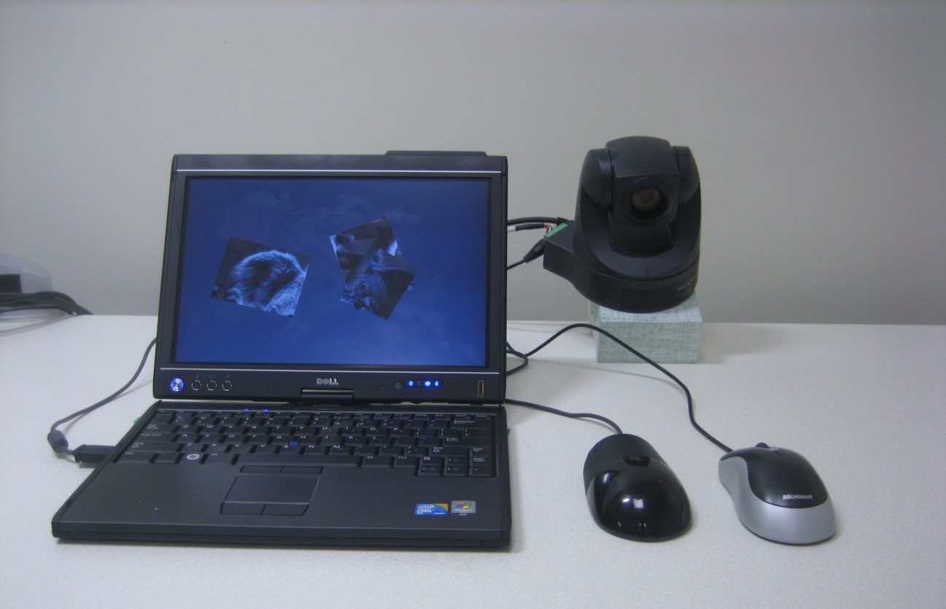
User Evaluation
12 participants (6 female)
2 tasks
90 min
6 techniques
x 2 rotations (± 60°)
x 2 scales (± 20%)
x 4 repetitions
= 96 trials/participant
Dell XT2
Camera
Standard Mouse
Cap Mouse

Slide 41
MT Mouse techniques were…
… slower,
… more error-prone,
… and less preferred!

Slide 42
Negative results

Slide 43
Lessons learned
MT mice interactions are better with focus and explicit touch activation
Combining mouse and touch to facilitate Surface-like interactions does not yield a good experience
Dexterity is in the thumb and index finger

Slide 44
Lessons learned (2)
Controlling accidental activation is key to user satisfaction
Interactions that treat mouse and touch streams independently do not suffer from same problems

Slide 45
Grips and Gestures
PART 3

Slide 46
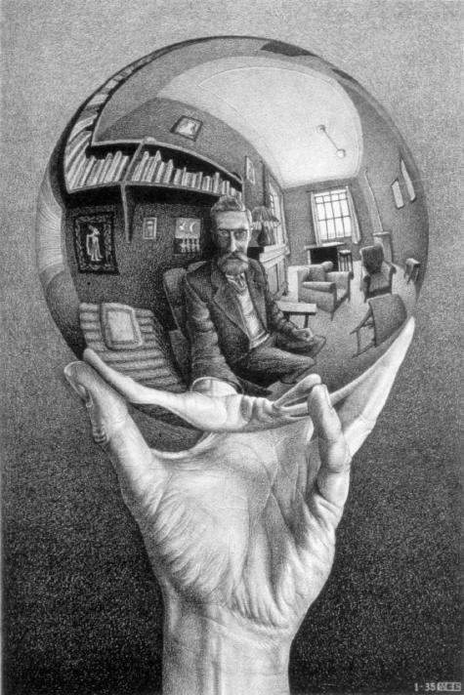
Challenge & Opportunity
The device is continuously held while interacting!
Fingers serve a dual purpose: to grip and to gesture

Slide 47
Bezel = Non-interactive (grip, hold, support)
Screen = interactive (touch)

Slide 48
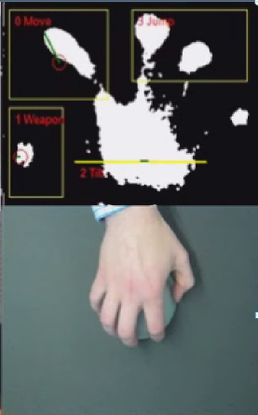
However,…
When the entire device is touch sensitive one can sense the context of use!
Engagement
Handedness
Different grips

Slide 49
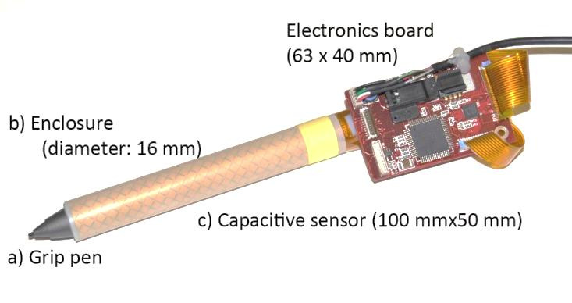
MTPen
Grips and Gestures on a Multi-touch Pen. To appear in CHI 2011.
Hyunyoung Song, Hrvoje Benko, Francois Guimbretiere, Shahram Izadi, Xiang Cao, and Ken Hinckley

Slide 50
Grip vs. Gesture
Raw
Dynamic

Slide 53
Making a product
Part 4

Slide 55
Microsoft Touch Mouse
Combines the virtues of a mouse with the rich natural language of gesture, bringing multi-touch gestures to Windows 7.

Slide 56
My role…
“Product Vision Lead” (?!?)
Control end-to-end experience
Design contact tracking and gesture recognition algorithms

Slide 57
Great mouse +
Grip
Click
Gesture

Slide 58
Finding the right form

Slide 59
Form explorations

Slide 60
Design lineage
Arc Mouse
Arc Touch
Microsoft Touch Mouse

Slide 61
Curved Wireless Capacitive Sensor

Slide 62
Gesture vocabulary
1 FINGER
Manage documents
2 FINGERS
Manage windows
3 FINGERS
Manage desktop

Slide 63
Gesture vocabulary = 1,2,3
Notes:
The brilliant thing about how we designed the gesture set is there’s an easy trick to figure out all of the gestures and learn them pretty quickly.
(click) The first thing they have to know is the planes of movement – forward, back, left, and right, and for thumb up and down
(click) Then they just have to remember one finger manages documents (forward back left right) and
(click) one thumb also manages documents, forward back up down. The smallest number of fingers controls the smallest element of the screen.
(click) If you want to move your windows around, it’s two fingers, forward back left right
(click) and the most fingers manages the biggest element, the desktop, forward and back
(click) the user doesn’t have to remember a specific gesture set at first, just the building blocks. Then they can try two fingers up down left and right until they get the window movement they want.
Users in the UR study were much more successful with tasks and had better retention if they used the UA materials. We actually saw people in the study who used the docs look at a window management task and then say, oh, it’s managing a window, so it must be a two-finger thing, and then they would figure it out. It stuck in their brains.
The tricky part is, we know there are users who simply won’t use anything that seems like help or documentation. The solution is to slide this 1/2/3 message in every place we can, so they absorb it without knowing they are doing it, similar to how Apple taught everyone the pinch gesture just by watching the commercial.
We need to hit this message everywhere we can, everywhere it makes sense: YouTube, marketing, press, presales, OOBE videos, packaging

Slide 65
Color, material, finish
Notes:
Since the form is so simple, I wanted to add another level of detail and visual interest through the CMF.
The laser etched grid is based on the printed design of the capacitive sensor below the surface. It adds a level of precision and provides a sort of coordinate system with a slight tactile feel for a user to trace their fingers across.
The way it’s positioned on the mouse, it tells the user where the active areas are.
Since this is something we’ve never done before, I’ve spent a lot of time in the model shop prototyping on our laser cutter. We’ve kicked off the Tier 2 manufacturer- Mibtech- that will be executing the parts in production, and I’ll plan on travelling there sometime in the POC2 timeframe to work with them and dial in the process before EV1.

Slide 66
Reducing accidental activation
Gesture recognition
Contact tracking
Understanding how the user holds the device

Slide 68
Best of CES 2011

Slide 69
In stores Summer 2011 - $79

Slide 70
Summary

Slide 71
Opportunity
To augment existing devices with multi-touch sensing:
Extend interaction vocabulary
Sense the context of their use
Solve difficult problems (palm rejection)

Slide 72
Thanks to my collaborators
Hrvoje Benko benko@microsoft.com http://research.microsoft.com/~benko

